Slide 1
Missing child Identification
Using deep learning

Slide 2
Group member Information
Shakeera Ahmade Shaik
Computer Science
Student ID : 700758700

Slide 3
Motivation
The project is motivated by three key factors:
Community: Bringing communities together to support missing child identification efforts.
Resilience: Showing resilience in the face of challenges encountered during the identification process.
Collaboration: Collaborating with various stakeholders to maximize the effectiveness of identification efforts.

Slide 4
Objectives
The main objectives of this project are:
1.Construction of a Deep Learning Model: Create a deep learning model using Convolution Neural Network, a highly effective deep learning technique for image-based applications is adopted here for face recognition. Face descriptors are extracted from the images using a pre-trained CNN model VGG-Face deep architecture
2. Compared with normal deep learning applications, our algorithm uses convolution network only as a high-level feature extractor and the child recognition is done by the trained SVM classifier.
3. The Convolutional Neural Network (CNN), a highly effective deep learning technique for image-based applications is adopted here for face recognition. Face descriptors are extracted from the images using a pre-trained CNN model VGGFace deep architecture.

Slide 5
Related work
Face Recognition Using Histograms Of Oriented Gradients Authors: O. Deniz, G. Bueno, J. Salido, and F. D. la Torre
Face recognition has been a long-standing problem in computer vision. Recently, Histograms of Oriented Gradients (HOGs) have proven to be an effective descriptor for object recognition in general and face recognition in particular. In this paper, we investigate a simple but powerful approach to make robust use of HOG features for face recognition.
Face Recognition Using Sift Features Authors: C. Geng and X. Jiang
Scale Invariant Feature Transform (SIFT) has shown to be a powerful technique for general object recognition/detection. In this paper, we propose two new approaches: Volume-SIFT (VSIFT) and Partial-Descriptor-SIFT (PDSIFT) for face recognition based on the original SIFT algorithm. We compare holistic approaches: Fisherface (FLDA), the null space approach (NLDA) and Eigenfeature Regularization and Extraction (ERE) with feature-based approaches: SIFT and PDSIFT.

Slide 6
Problem Statement
As we know that the USA is one of the largest country in the world if it comes to population. And there are many of children among us. As there is a great saying “TODAYS CHILDREN ARE TOMORROWS CITIZENS”. There are many situations we see a child who is missed in one state may found in another state. And also consider a case like a child is too young to speak or remember his/her address or not able to identify the parents So we would like to develop Missing child identification system using Deep Learning.

Slide 7
Proposed Solution
The public is given provision to voluntarily take photographs of children in suspected situations and uploaded in that portal. Automatic searching of this photo among the missing child case images will be provided in the application. This supports the police officials to locate the child anywhere in India. When a child is found, the photograph at that time is matched against the images uploaded by the Police/guardian at the time of missing. Sometimes the child has been missing for a long time. This age gap reflects in the images since aging affects the shape of the face and texture of the skin. The feature discriminator invariant to aging effects has to be derived. This is the challenge in missing child identification compared to the other face recognition systems. Also, facial appearance of child can vary due to changes in pose, orientation, illumination, occlusions, noise in background etc. The image taken by public may not be of good quality, as some of them may be captured from a distance without the knowledge of the child. A deep learning architecture considering all these constrain is designed here.

Slide 8

Results/Simulations
In this screen public can click on ‘Public Upload Suspected Child’ link to get below page and to add missing child details
Fig.9.1: Output screen

Slide 9
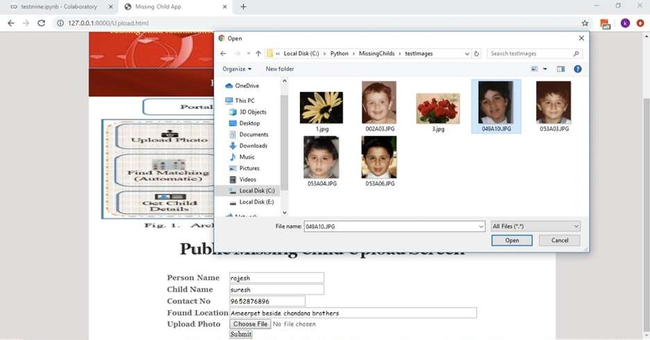
Results/Simulations
In this screen public will enter suspected child details and then upload photo and then click on ‘Submit’ button.
Fig.9.2: Output screen

Slide 10

Results/Simulations
In below screen we can see child not found in missing DB and we can try with another image
Fig.9.3: Output screen

Slide 11
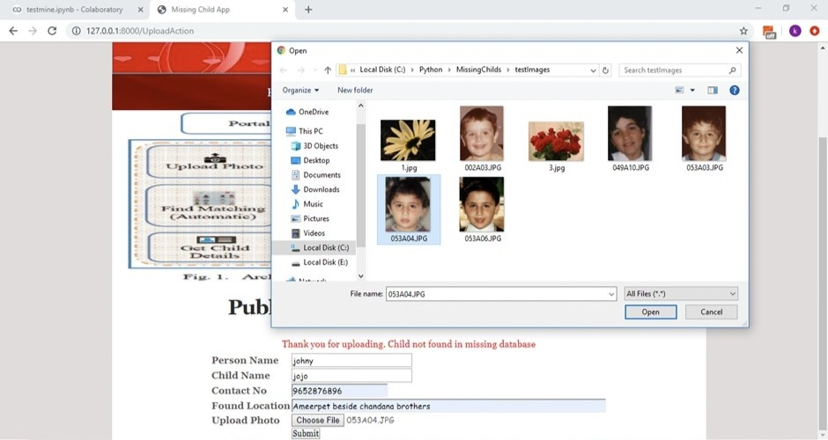
Results/Simulations
In this screen public will enter another suspected child details and then upload photo and then click on Submit button
Fig.9.4: Output screen

Slide 12

Results/Simulations
And this is the result for new above child details
Fig.9.5: Output screen

Slide 13

Results/Simulations
In above screen uploaded child found in database and now click on ‘Official Login’ link to get below login screen. Now admin can login by entering username and password as ‘admin’ and ‘admin’. After clicking on ‘Login’ button

Slide 14

Results/Simulations
In below screen official can click on ‘View Public Upload Missing Childs Status’ link
to view all uploads and its result done by public

Slide 15
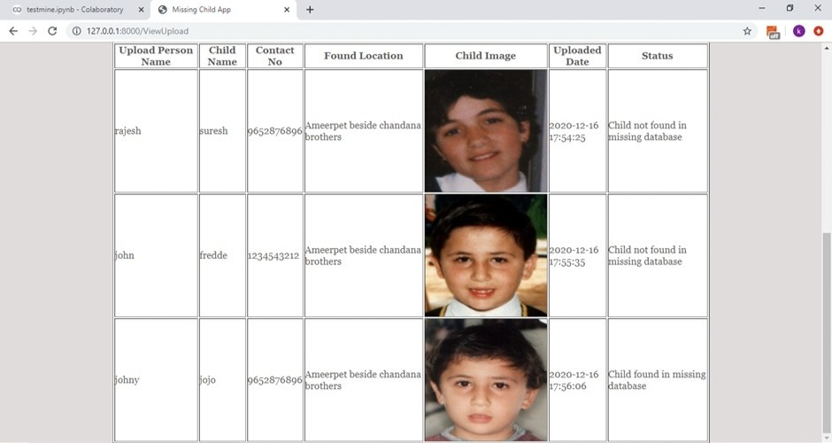
Results/Simulations
In below screen the result done by public is shown. Officials can see all details and then take action to find that child.

Slide 16
References
[1]. Y. LeCun, Y. Bengio, and G. Hinton, "Deep learning", Nature, 521(7553):436– 444, 2015.
[2]. O. Deniz, G. Bueno, J. Salido, and F. D. la Torre, "Face recognition using histograms of oriented gradients", Pattern Recognition Letters, 32(12):1598–1603, 2011.
[3]. C. Geng and X. Jiang, "Face recognition using sift features", IEEE International Conference on Image Processing(ICIP), 2009.
[4]. Rohit Satle, Vishnuprasad Poojary, John Abraham, Shilpa Wakode, "Missing child identification using face recognition system", International Journal of Advanced Engineering and Innovative Technology (IJAEIT), Volume 3 Issue 1 July- August 2016.

